Slide 1
Python embedded in
LibreOffice or OpenOffice documents
Hamilton Python Users Group
Ian Stewart
11-Oct-2021

Slide 2
Python embedded in LO/OO documents
LibreOffice and OpenOffice applications default to allowing BASIC macros to be stored within a Document.
Python macros may also be stored within a document.
Inserting Python macros is made easier using the LibreOffice addon, “alternative Python script organizer”, ASPO.

Slide 3
BASIC embedded in LO/OO documents (default)

Slide 4
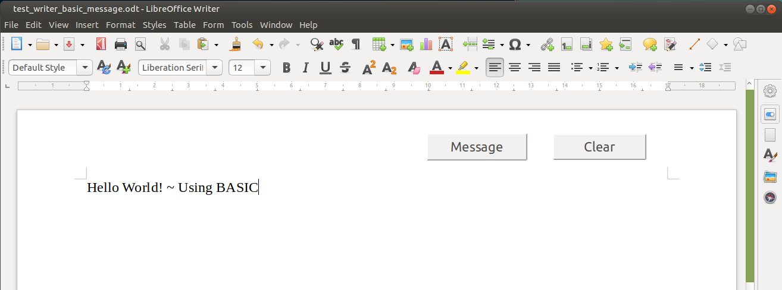
BASIC embedded in LO/OO documents
Writer document with two push buttons that execute BASIC code...

Slide 5
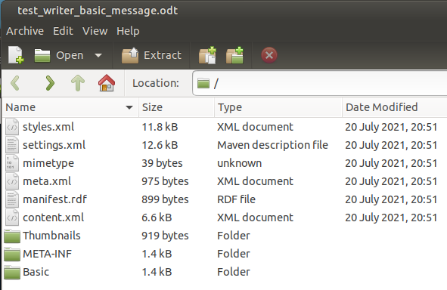
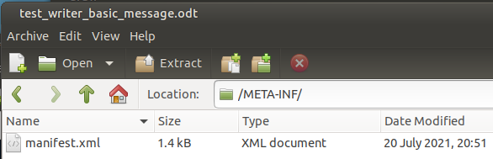
Unzipping of Writer document “test_writer_basic_message.odt”...

Slide 6
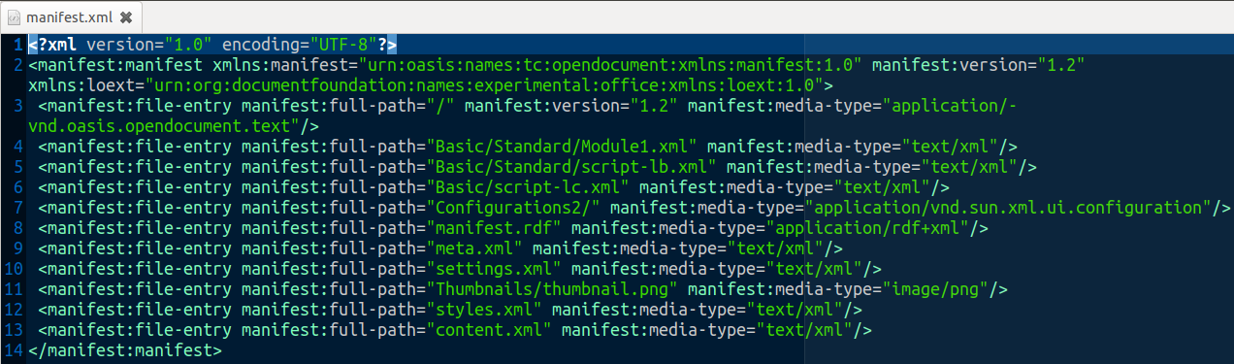

“manifest.xml” lists BASIC scripts are included...

Slide 7
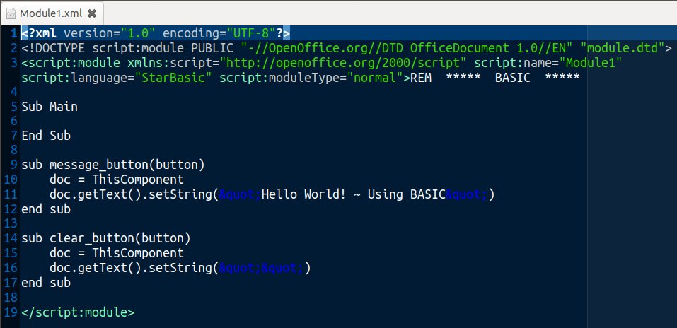
BASIC/Standard/Module1 has the BASIC script for each push button to execute...

Slide 8
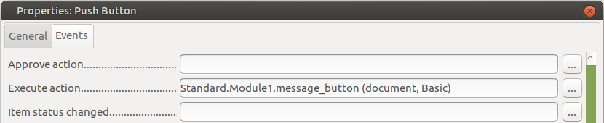
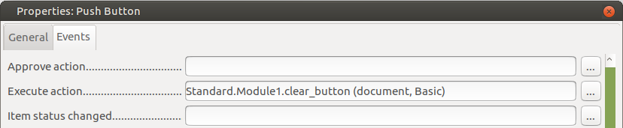
“Execute Action” has description of path to push button BASIC subroutines for “Message” and “Clear”...

Slide 9
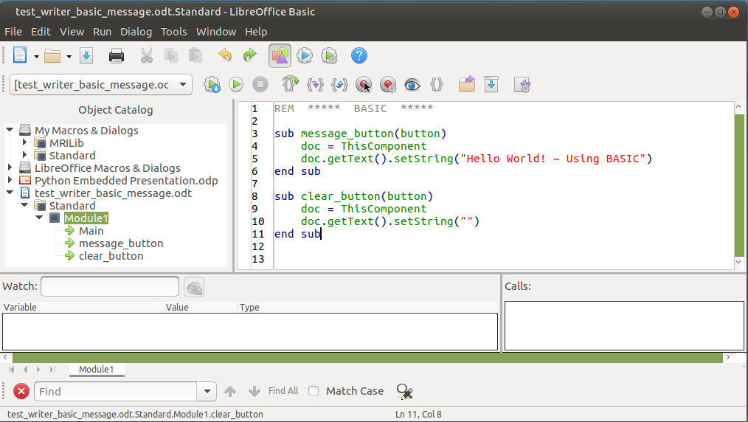
BASIC IDE: Tools --> Macros --> Edit Macros.

Slide 10
Python embedded in LO/OO documents

Slide 11
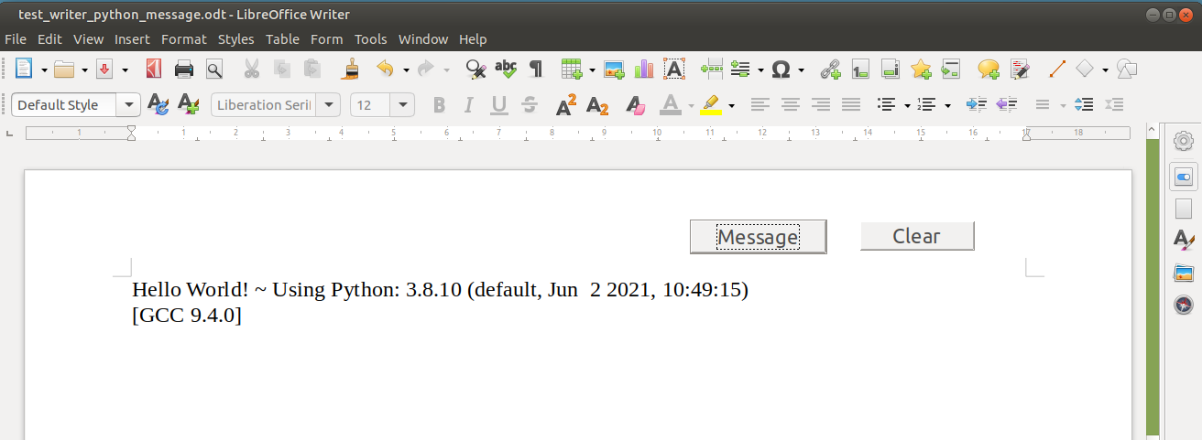
Python embedded in LO/OO documents
LibreOffice and OpenOffice applications with Python macros stored in a Document.

Slide 12
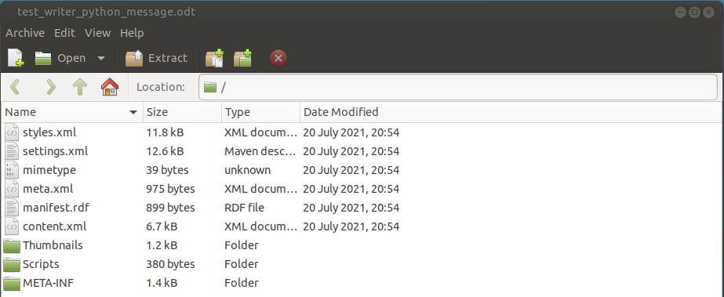
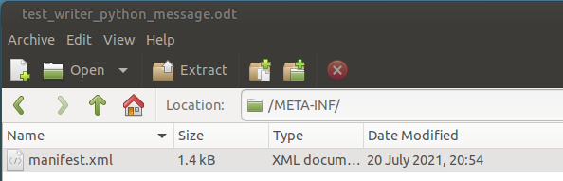
Unzipping of Writer document to view the embedded Python macros

Slide 13
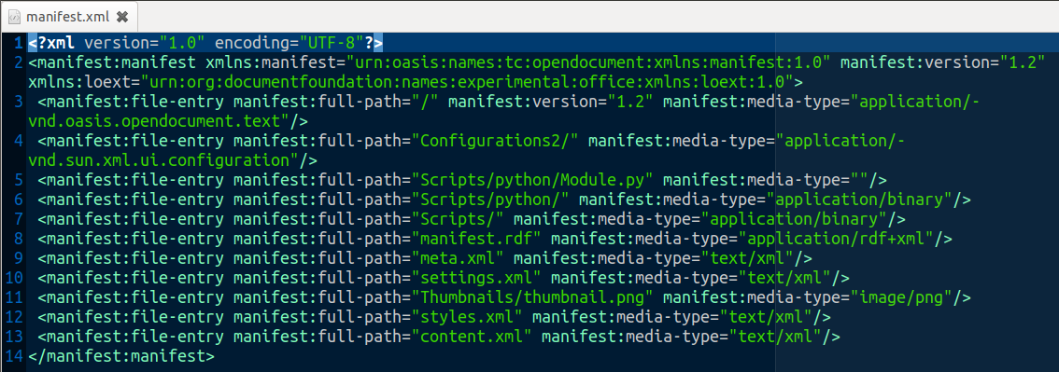

“manifest.xml” file contains references to the Python files.

Slide 14
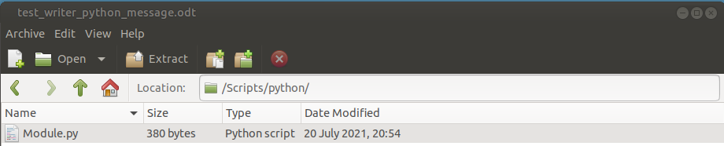
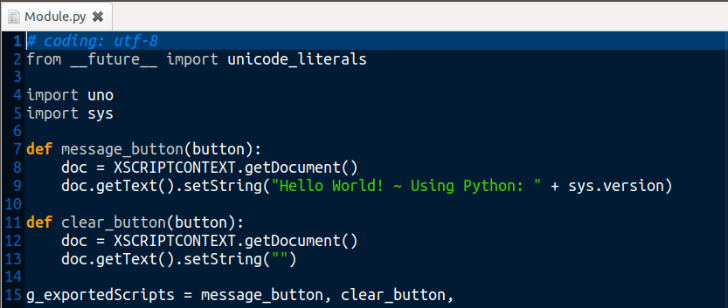
Python script in “Module.py”, in “test_writer_python_message.odt” file...

Slide 15

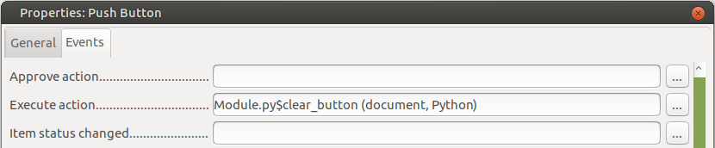
Push button events for “message” and “clear” buttons...

Slide 16
Alternative Python Scripts Organizer (APSO)

Slide 17
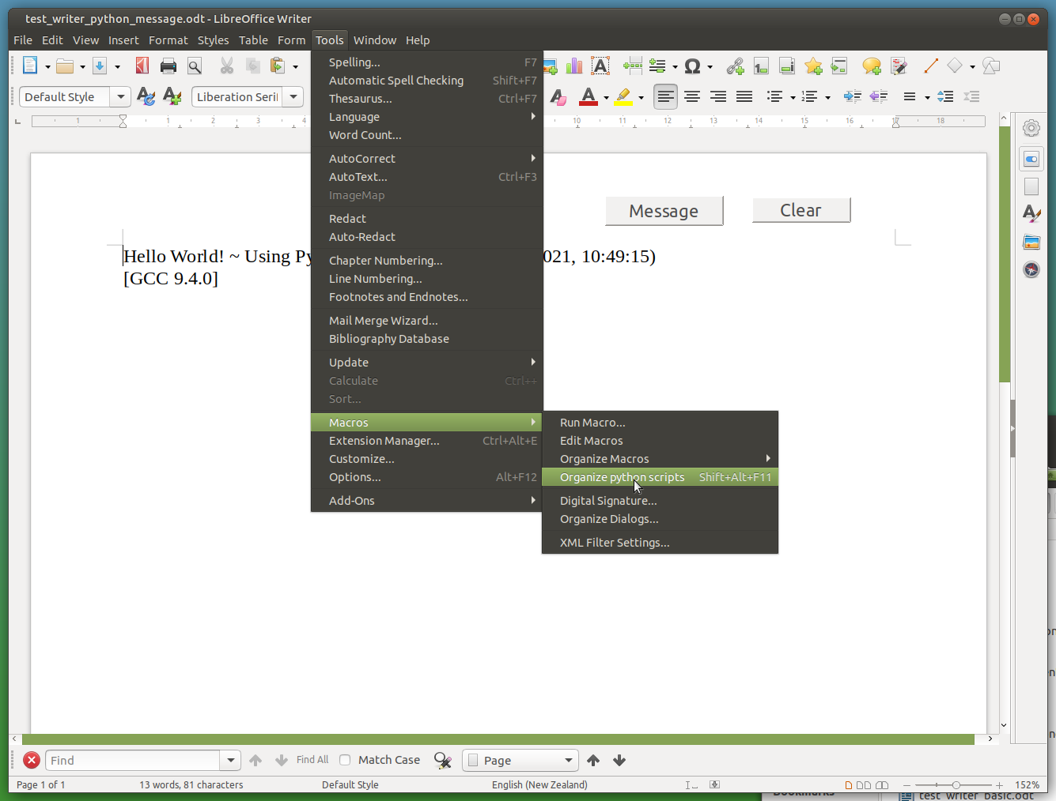
APSO ~
Alternative
Python
Scripts
Organizer

Slide 18
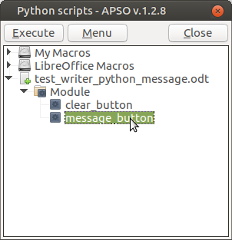
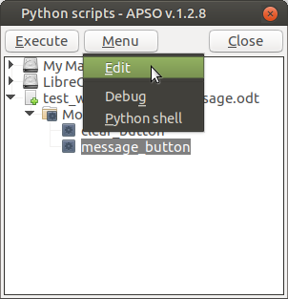
APSO

Slide 19
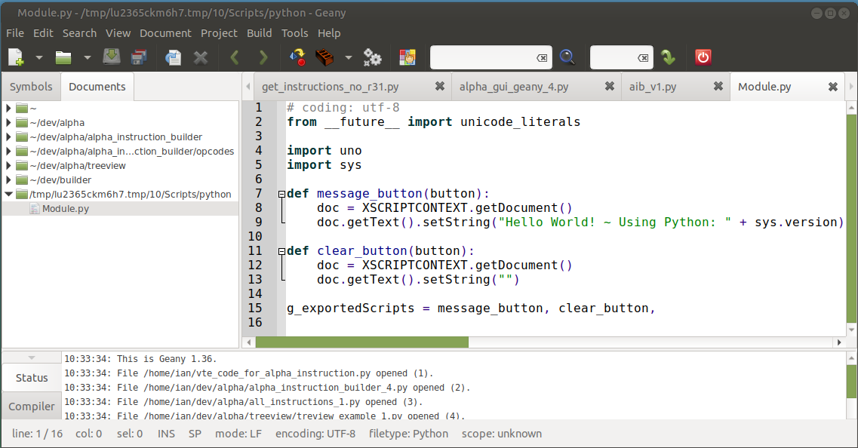
Example of “Geany” as the Python IDE.

Slide 20
APSO ~ Dependency Notes
Advised to install the MRI extension for LibreOffice
Install the default-jre.
$ sudo apt install jre-default
Install libreoffice-script-provider-python
$ sudo apt install libreoffice-script-provider-python

Slide 21
APSO ~ Download and Addon of Extension

Slide 22
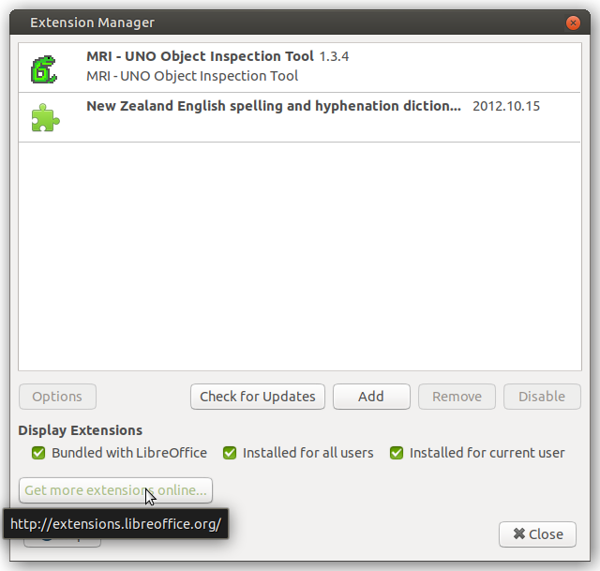
APSO
Performing Addon Extension
for LibreOffice

Slide 23
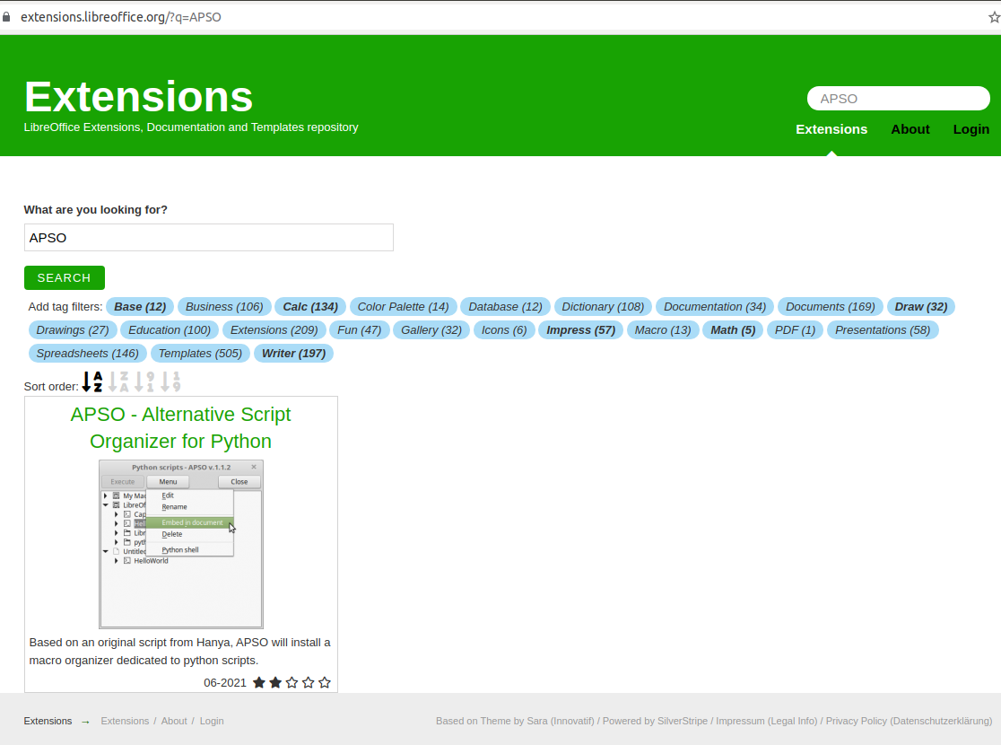
APSO Addon

Slide 24
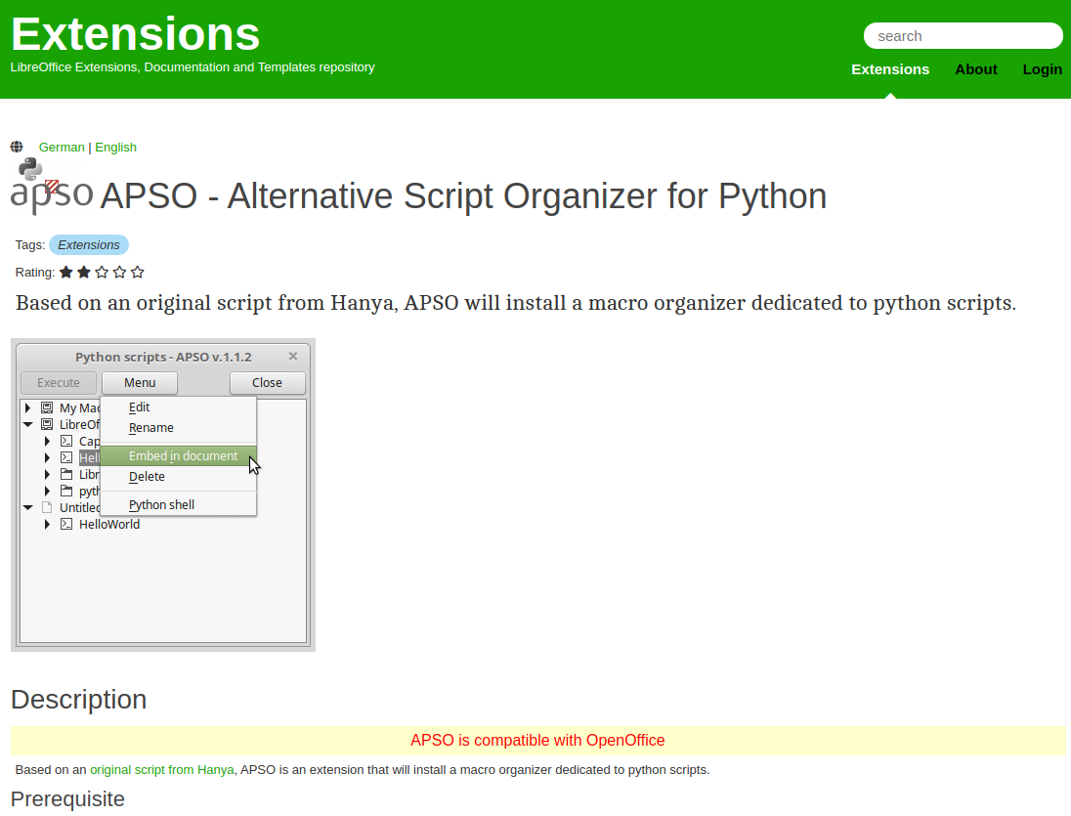
APSO Addon.

Slide 25
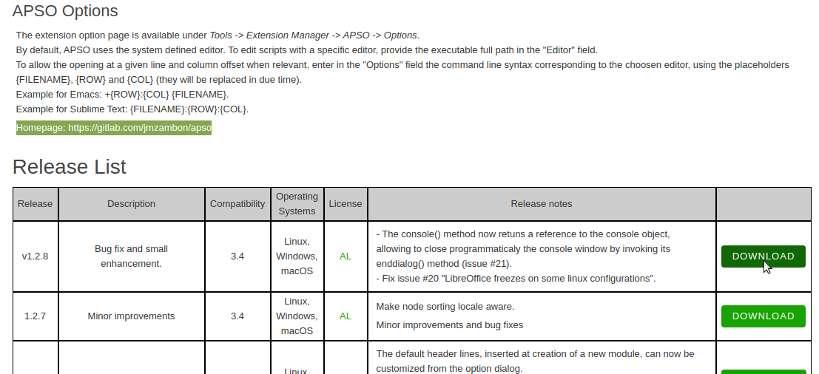
APSO Addon.
Download to Downloads folder...

Slide 26
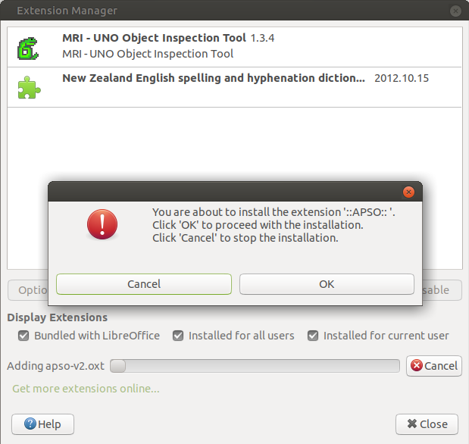
APSO Install addon from
Downloads folder

Slide 27
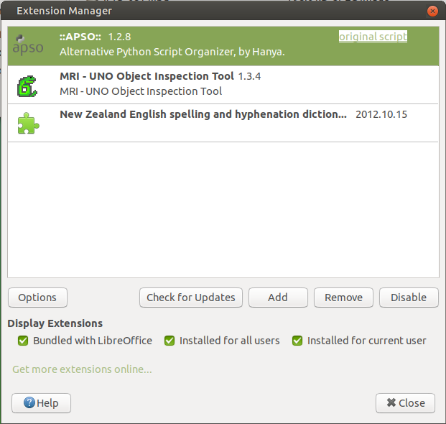
APSO addon installed.

Slide 28
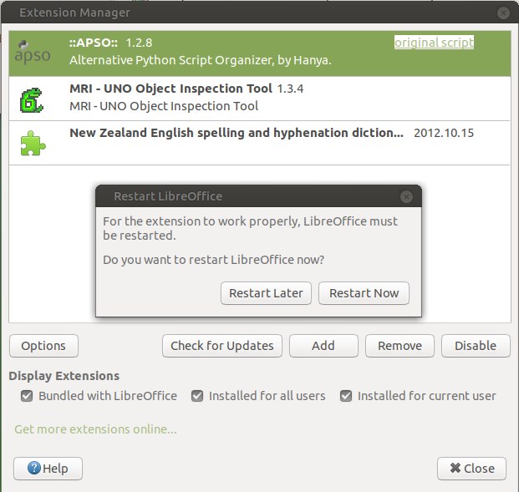
APSO addon installed.

Slide 29
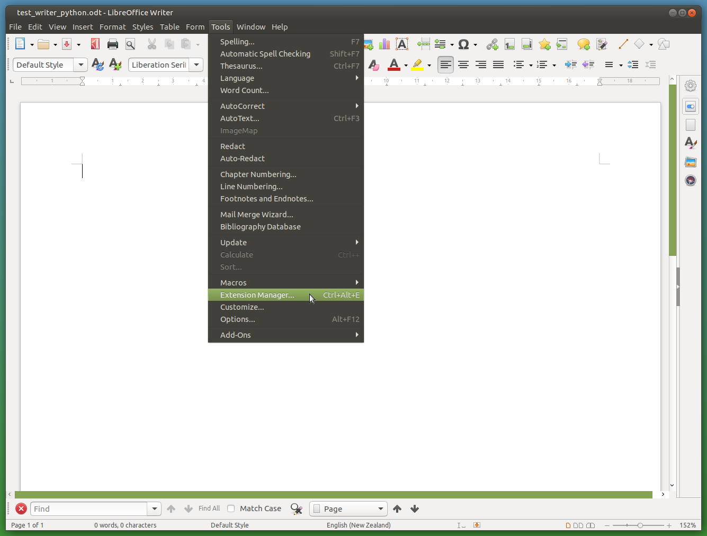
APSO
Tailoring editor.
Tools -->
Extension Manager...

Slide 30
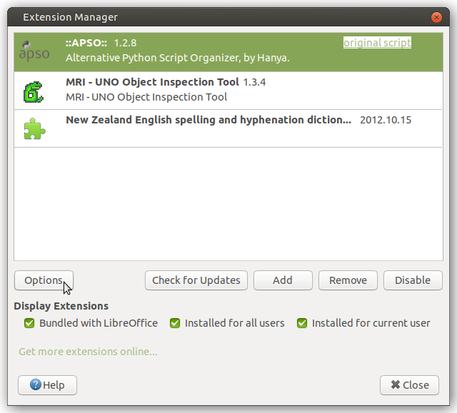
Tools -->
Extension Manager... -->
APSO --> Options

Slide 31
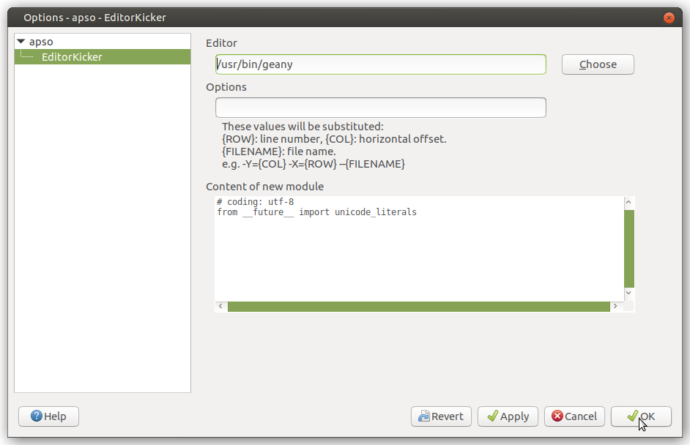
APSO.
Choose
Python
IDE...

Slide 32
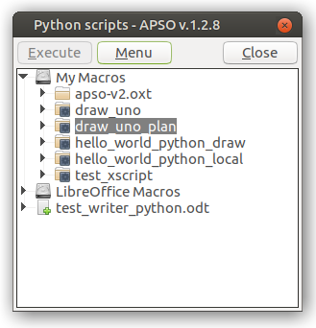
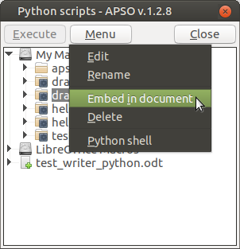
Python Moving from My Macros to Embedded in document.

Slide 33
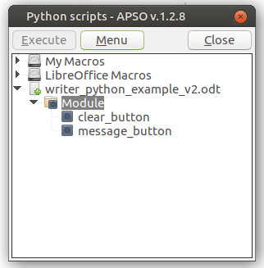
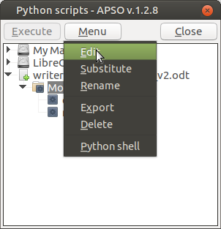
Python Embedded in document. Start Editing.

Slide 34
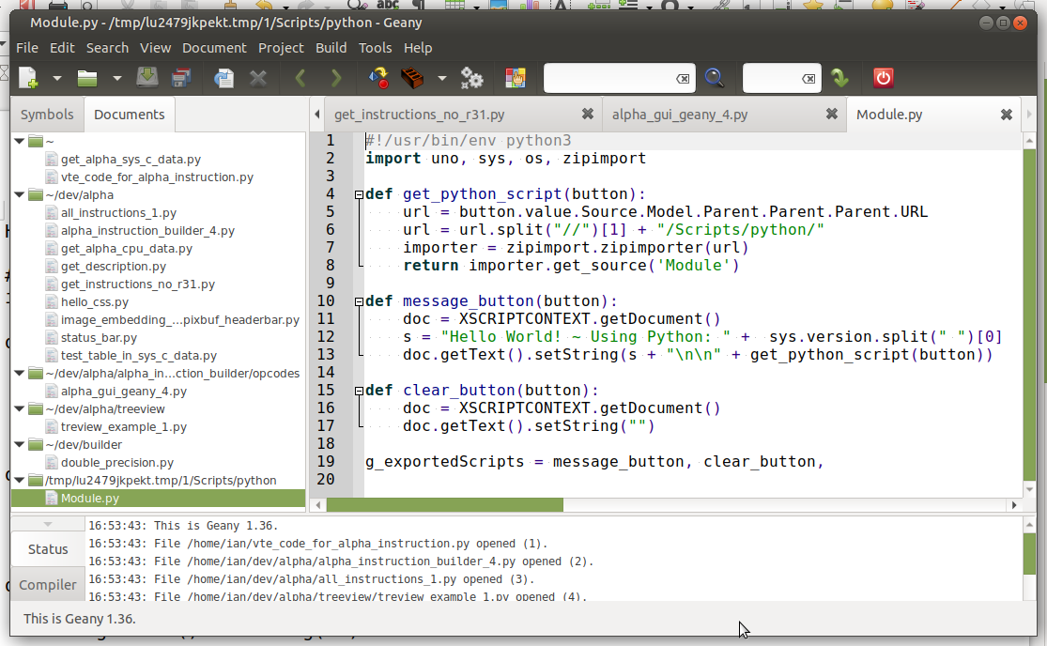
Python Embedded in document. Editing using Geany.

Slide 35
XSCRIPTCONTEXT

Slide 36
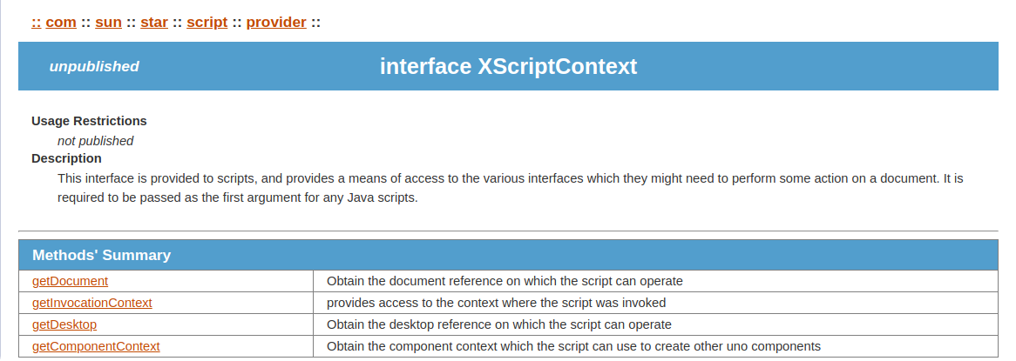
XSCRIPTCONTEXT.
http://www.openoffice.org/api/docs/common/ref/com/sun/star/script/provider/XScriptContext.html

Slide 37
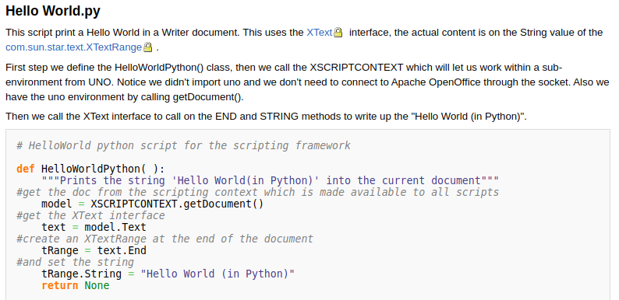
PyUNO Samples
https://wiki.openoffice.org/wiki/PyUNO_samples

Slide 38
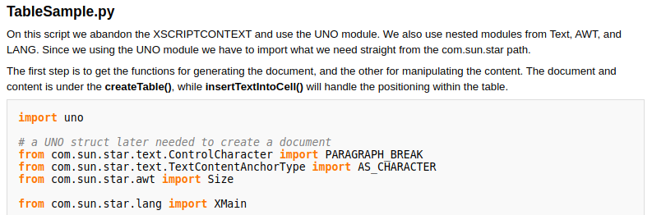
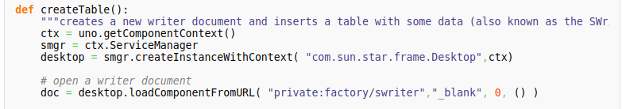
Python code resides in “My Macros & Dialogs”: ~/.config/libreoffice/4/user/Scripts/python/TableSample.py
OR LibreOffice Macros & Dialogs:
/usr/lib/libreoffice/share/Scripts/python/pythonSamples/TableSample.py
Create a socket:
$ libreoffice --writer –accept="socket,host=localhost,port=2002;urp;StarOffice.ServiceManager"
Instead of:
desktop = XSCRIPTCONTEXT.getDesktop()
...more codes... See: https://wiki.openoffice.org/wiki/PyUNO_samples

Slide 39
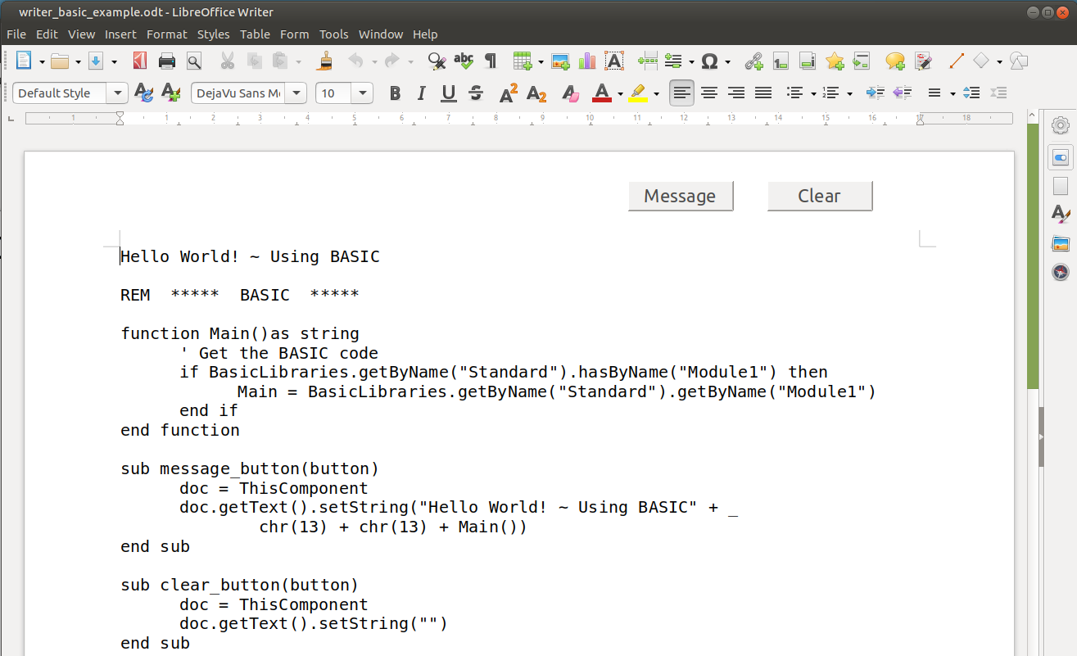
BASIC Sample. Retrieve and Display

Slide 40
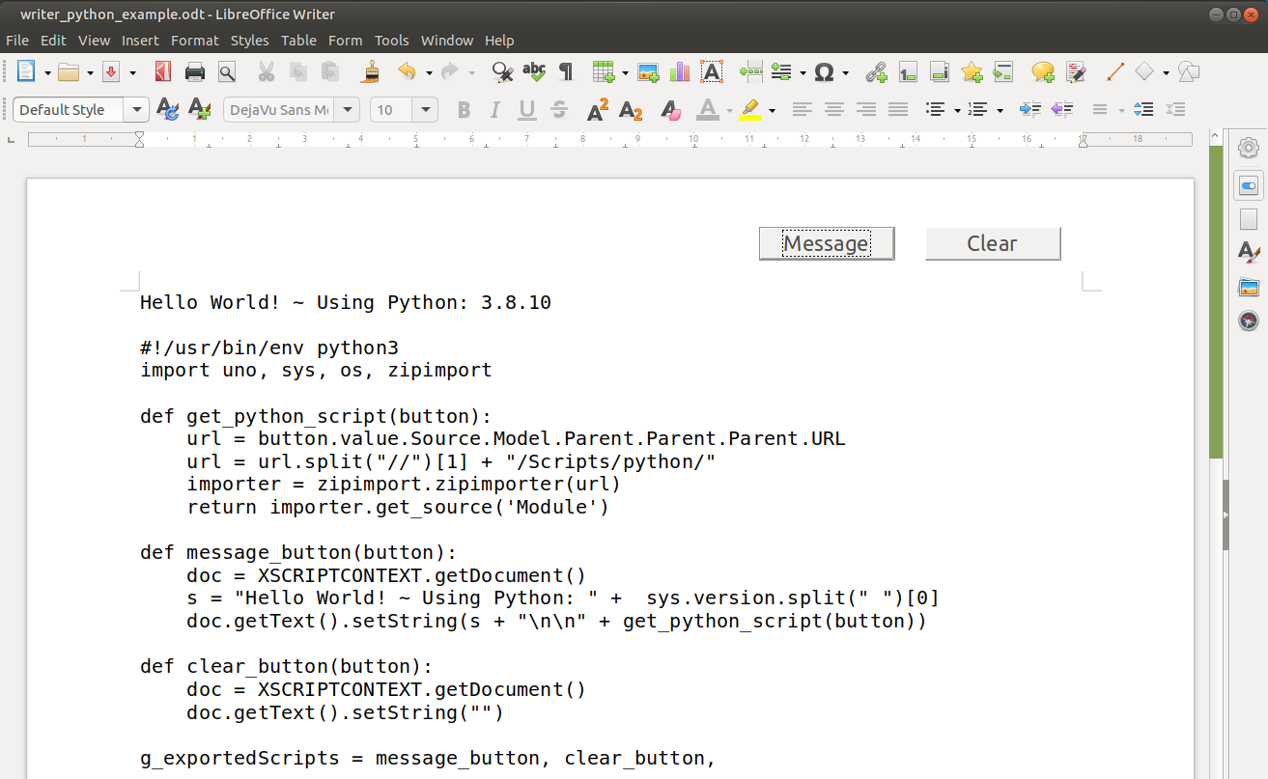
Python Sample. Retrieve and Display

Slide 41
Demo: Floor Plan ~ Draw documents
End.

Slide 42
Todo:
Weird stuff that gets introduced to Python
Block diagrams.

Slide 43
https://help.libreoffice.org/7.1/en-GB/text/sbasic/python/python_programming.html?&DbPAR=BASIC&System=UNIX
...Differences between Python and Basic
#url = str(Path("writer_python_example_v2.odt/Scripts/python").resolve())
# /home/ian/writer_python_example_v2.odt/Scripts/python
# The following full URL is OK...
#url = "/home/ian/dev/draw/writer_python_example_v2.odt/Scripts/python"
# The folllowing with tilde. No OK..
#url = "~/dev/draw/writer_python_example_v2.odt/Scripts/python"
#url = os.path.abspath("writer_python_example_v2.odt/Scripts/python")
# /home/ian/writer_python_example_v2.odt/Scripts/python
#url = os.path.abspath(__file__) # # /home/ian/vnd.sun.star.tdoc:/34/Scripts/python/Module.py
#url = ("/").join(url.split("/")[:-1])
# Above builds sting correctly... but not a zip file???
#===
a_message = os.getcwd()
#a_message = str(Path(__file__).parent.resolve()) # /home/ian/vnd.sun.star.tdoc:/1/Scripts/python
#a_message = sys.path[0] # /usr/lib/libreoffice/program
#a_message = os.path.realpath(__file__) # /home/ian/vnd.sun.star.tdoc:/1/Scripts/python/Module.py
#a_message = os.path.dirname(os.path.realpath(__file__)) # return /home/ian/vnd.sun.star.tdoc:/1/Scripts/python
#returns directory with the file.
#a_message = os.path.dirname(os.path.realpath("__file__")) #return /home/ian
_embedded_plan.py$button_start (document, Python)
draw_embedded_plan.py$button_clear (document, Python)
draw_embedded_plan.py$button_push_event (document, Python)

Slide 44
https://help.libreoffice.org/7.1/en-GB/text/sbasic/python/python_programming.html?&DbPAR=BASIC&System=UNIX
...Differences between Python and Basic
#!/usr/bin/env python3
import uno, sys, os, zipimport
def get_python_script(button):
url = button.value.Source.Model.Parent.Parent.Parent.URL
url = url.split("//")[1] + "/Scripts/python/"
importer = zipimport.zipimporter(url)
return importer.get_source('Module')
def message_button(button):
doc = XSCRIPTCONTEXT.getDocument()
s = "Hello World! ~ Using Python: " + sys.version.split(" ")[0]
doc.getText().setString(s + "\n\n" + get_python_script(button))
def clear_button(button):
doc = XSCRIPTCONTEXT.getDocument()
doc.getText().setString("")
g_exportedScripts = message_button, clear_button,

